Slide 1
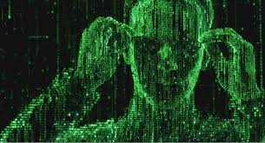
Artificial intelligence : neural networks

Slide 2
summary
What is Artificial intelligence
How is it made
Neural network
Genetic algorithm

Slide 3
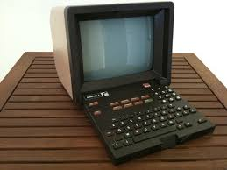
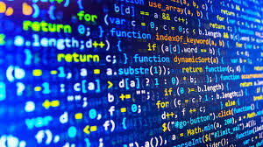
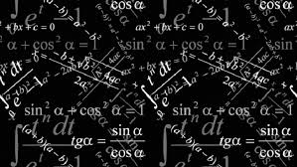

What is artificial intelligence
Artificial intelligence is:
Artificial intelligence is not :
+

Slide 4
Neural Network

Slide 5
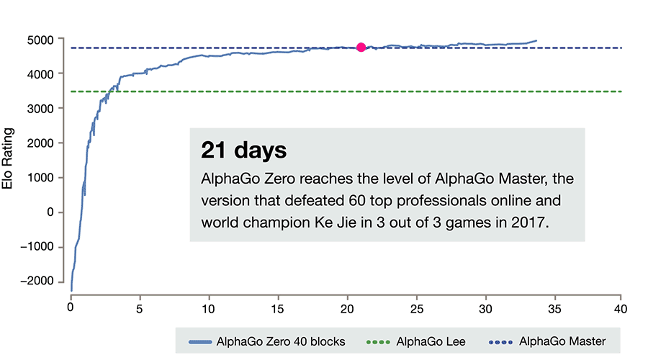
Neural Network
TensorFlow

Slide 6
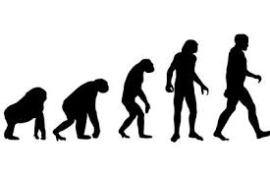
Genetic algorithm

